Slide 1

Do safety-funded construction projects reduce crash rates in Ohio?
Levi Sayles
Notes:
For my capstone project I've been working on a question that I think is directly relevant to what your team does every day — do safety-funded construction projects actually reduce crash rates in Ohio? I've spent the semester building a data pipeline that combines crash records, road inventory data, pavement condition scores, and ODOT construction project data to try and answer that question rigorously. Today I want to share what I've found, walk you through some specific examples from Hamilton County, and get your perspective on whether these findings match what you see on the ground.

Slide 2
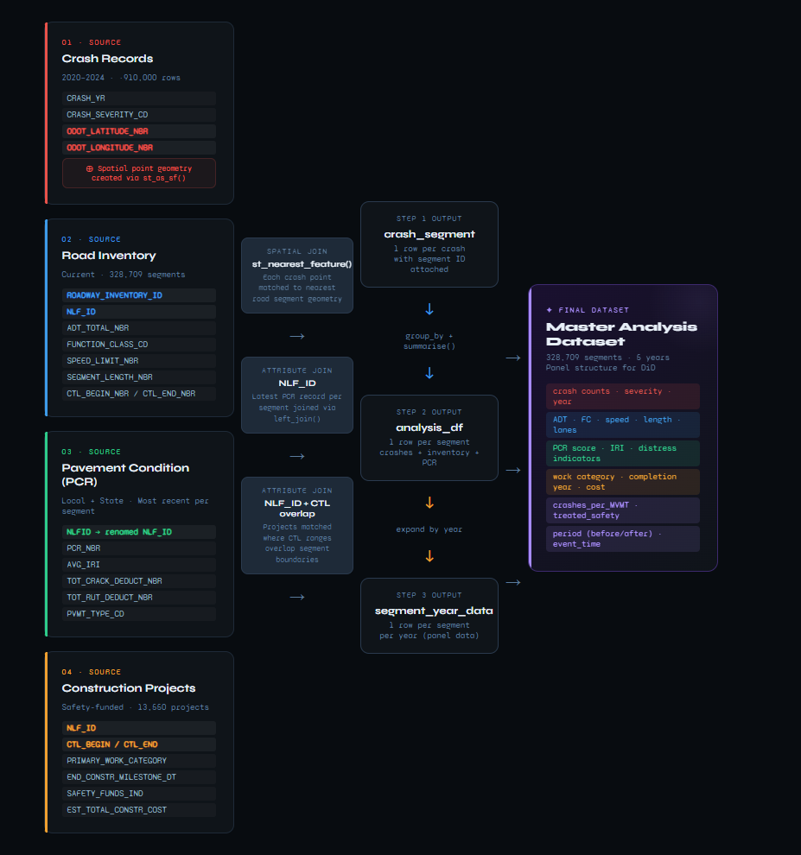
Data Overview
Crash data: 2020–2024, ~910k records, columns used (lat/long, severity, year)
Road Inventory: 328k segments, columns used (ADT, functional class, speed limit, segment length)
PCR: pavement condition scores, distress indicators
Construction Projects: 13,550 safety-funded projects, columns used (NLF_ID, CTL begin/end, completion date, work category, safety funds indicator)
Notes:
Let me quickly walk through the data I used. The backbone is five years of crash records from 2020 to 2024 — about 910,000 individual crash events across Ohio, each with a location, severity, and year. I joined those spatially to ODOT's road inventory, which has one row per road segment and tells you things like how much traffic uses that road, what class of road it is, speed limit, and lane width. I also brought in pavement condition data which gives each segment a quality score and tracks specific distress indicators like rutting and cracking. And finally the construction project data — 13,550 safety-funded projects with location info, project type, and completion dates. These four sources were combined into a single master dataset of 328,000 road segments, each with a crash history, road characteristics, pavement condition, and a flag for whether it received safety investment.
The crash records are the core — 910,000 crash events across Ohio from 2020 to 2024, each with a GPS location, severity, and year. Since crashes are recorded as points on a map and roads are lines, I couldn't match them on a shared ID. Instead I used a spatial join — basically asking the software to find the nearest road segment to each crash point and attach that segment's ID to the crash record.
Once crashes were linked to segments I joined in the road inventory data, which tells you the physical characteristics of each segment — how much traffic it carries, what type of road it is, speed limit, and length. That length is important because it lets me calculate a standardized crash rate rather than just raw counts, so I can fairly compare a short urban road to a long rural highway.
Pavement condition was a straightforward join on a shared route ID — I just kept the most recent inspection record per segment.
The construction projects join was the most complex. Roads and projects are both defined by a route and a start and end milepost. So instead of matching on a single ID I had to check whether the milepost ranges overlapped — essentially asking 'does this project physically cover this segment?' That sounds complicated but the logic is simple: if the project ends after the segment starts, and the project starts before the segment ends, they overlap.
The end result is one clean dataset — 328,000 segments, five years, with everything attached. That's what every analysis in this presentation is built on.

Slide 3
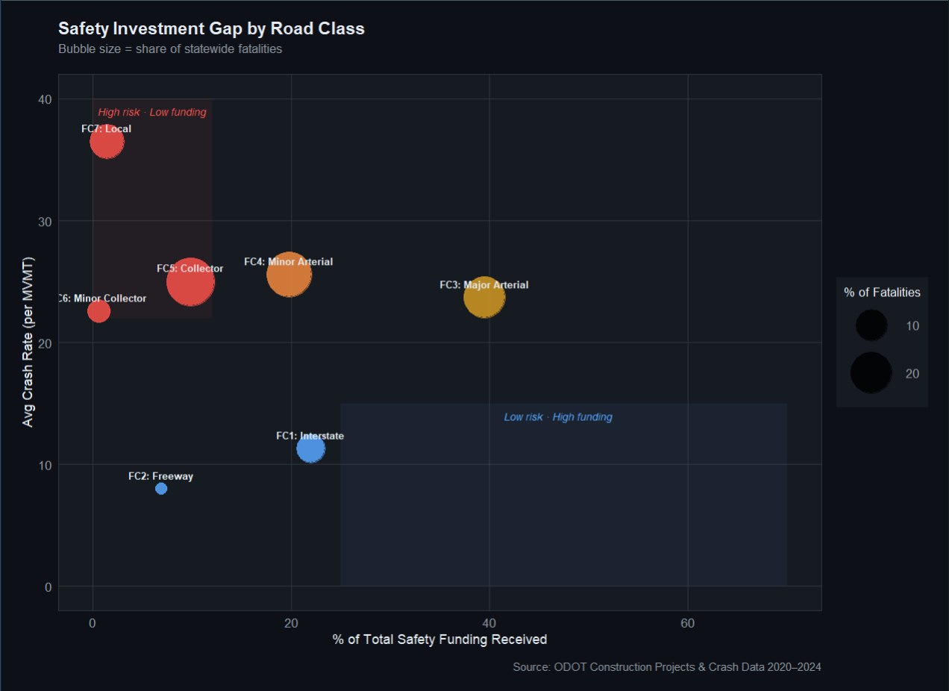
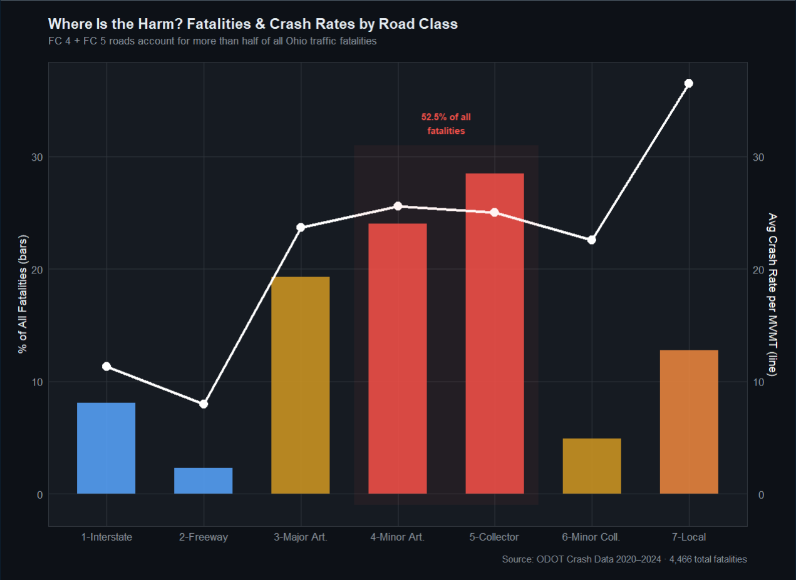
Statewide Risk Profile
Notes:
Before getting into whether construction works, I want to show you where the risk actually is in Ohio's road network — and I want to make the case two different ways so there's no ambiguity.
The first way is the standard crash rate per million vehicle miles traveled. By that measure local roads are the most dangerous in the network at 36.5 crashes per MVMT — more than three times the rate of major arterials. But I know the pushback to that — local roads carry very little traffic so even a handful of crashes produces a high rate. Fair point.
So let's look at raw numbers instead. FC4 minor arterials had 250,000 crashes and 1,074 fatalities over five years — the single largest share of any road class, 27.5% of all crashes statewide. FC5 collectors had 219,000 crashes and 1,273 fatalities — the highest fatality count of any road class in Ohio. Together FC4 and FC5 account for over half of all crashes and over half of all fatalities in the state. That is not a statistical artifact of low traffic volume. Those are real crashes on genuinely dangerous roads.
Now look at where the money goes. This bubble chart puts funding on the x-axis and crash rate on the y-axis, with bubble size representing share of fatalities. What you want to see is money flowing to the top left — high risk roads. What you actually see is the opposite. FC3 major arterials capture nearly 40 cents of every safety dollar despite sitting at moderate risk. FC5 collectors — the road class with the most fatalities in Ohio — receive less than 10% of total safety funding. Local roads, with 100,000 crashes and 573 fatalities over five years, receive 1.4 cents of every safety dollar.
So regardless of whether you look at crash rates or raw counts, the same roads keep coming up as underserved — and the same roads keep showing up as over-resourced relative to their actual risk.

Slide 4
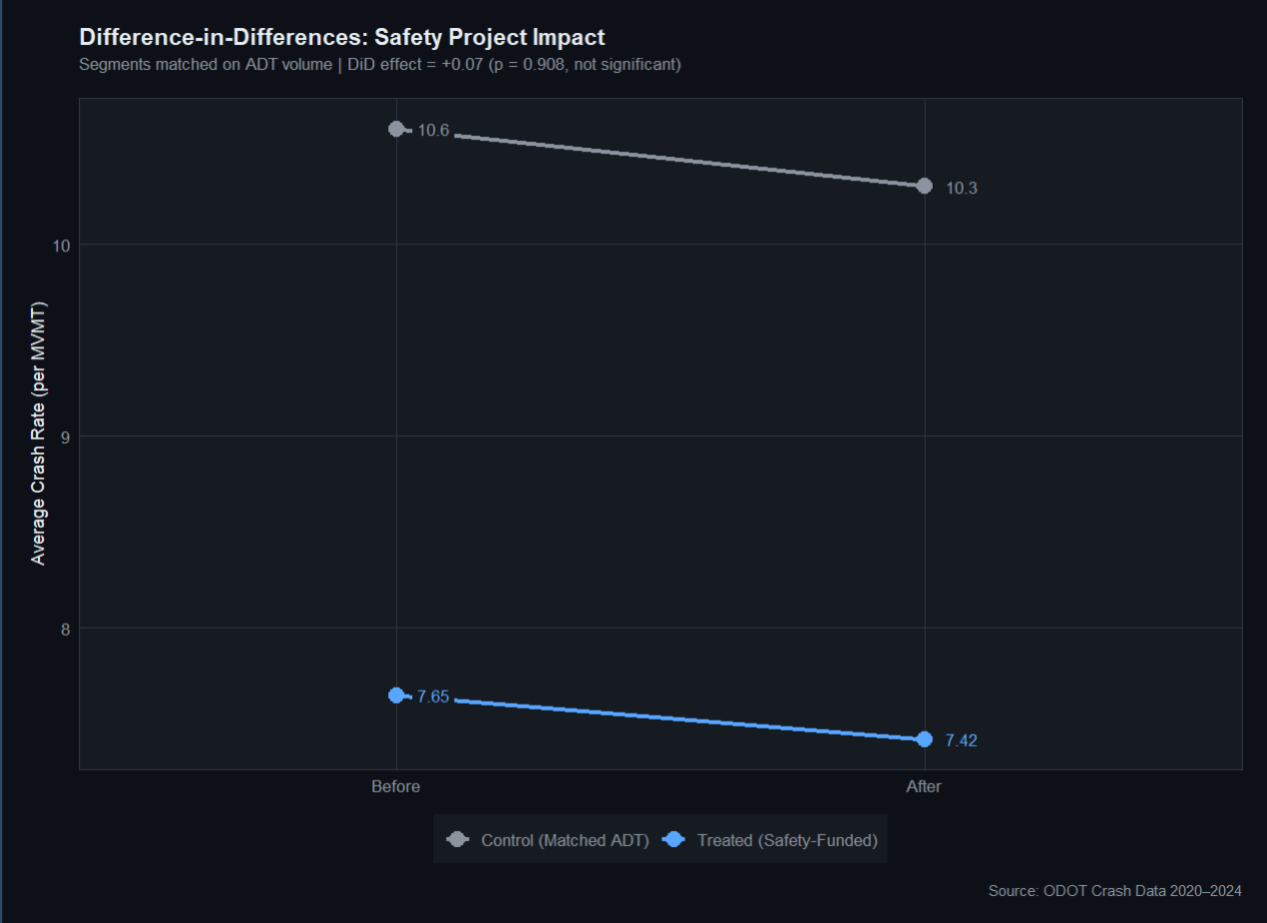
Are Safety Projects Reducing crashes?
Notes:
Now the core question — do these projects work? To answer this I used a difference-in-differences design, which compares how crash rates changed on treated roads versus comparable untreated roads over the same time period. I matched treated and control roads by traffic volume so I was comparing similar roads rather than local roads to interstates.
The parallel trends plot on the left shows that before construction, treated and control roads were moving in roughly the same direction — which is the key assumption that makes this comparison valid.
The result on the right shows that both groups improved slightly after the treatment period, but the treated group improved by almost exactly the same amount as the control group. The difference-in-differences effect is +0.07 crashes per MVMT with a p-value of 0.908 — statistically indistinguishable from zero. Safety-funded projects overall are not producing measurable crash reductions relative to comparable untreated roads.

Slide 5
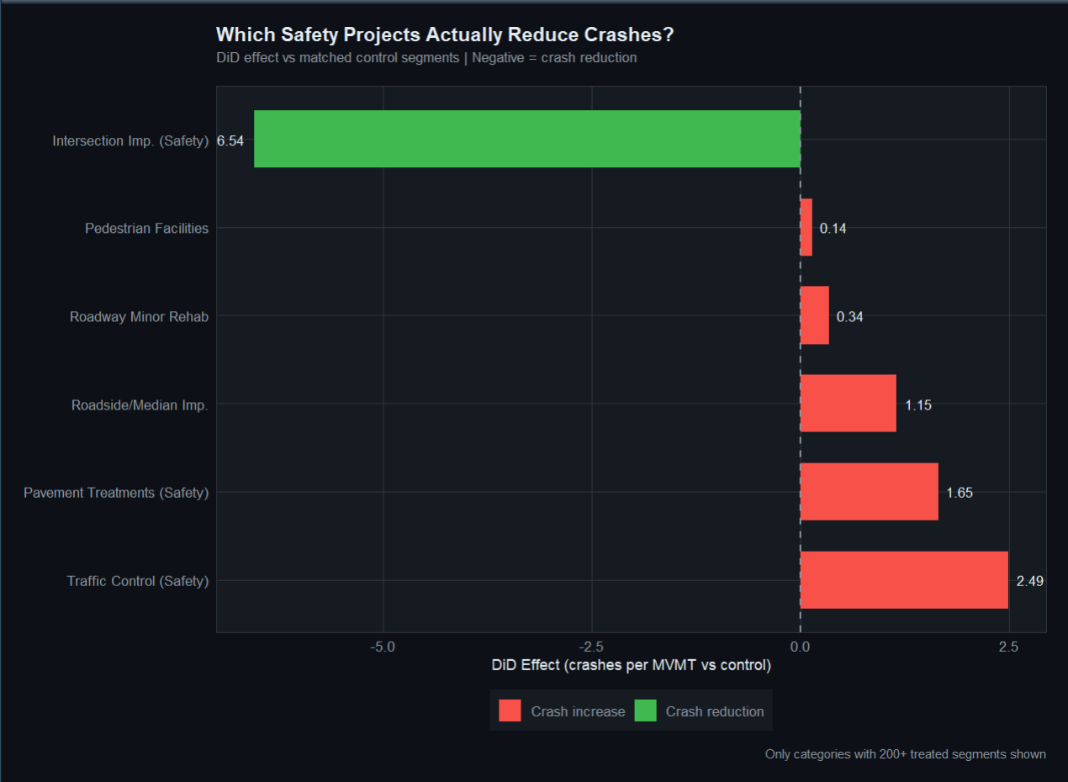
But Not All Projects Are Equal
Notes:
That overall null result hides something important. When I break the analysis down by project type, a very different picture emerges. This chart shows the DiD effect for each major work category. Every bar to the left of zero means that category reduced crashes relative to control roads. Every bar to the right means it made things worse.
One category stands out clearly — intersection improvements show a reduction of 6.5 crashes per MVMT. That's a real, meaningful safety effect. Every other category is either at zero or slightly positive, meaning no improvement or marginal worsening.
The cost effectiveness table makes this even clearer. The Plainfield Road roundabout project in Hamilton County cost $8.9 million but reduced crashes by 5.1 units per million dollars spent. The Eastern Corridor traffic control project cost only $337,000 but increased crashes by 44 units per million dollars — a negative return on investment. An expensive project that works is better than a cheap project that makes things worse.

Slide 6
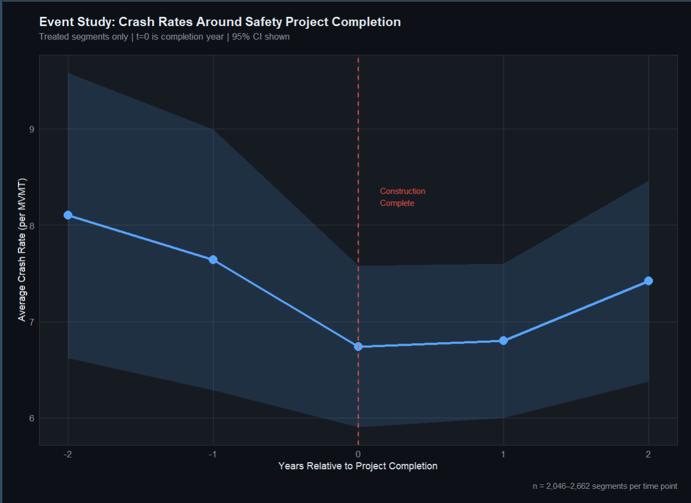
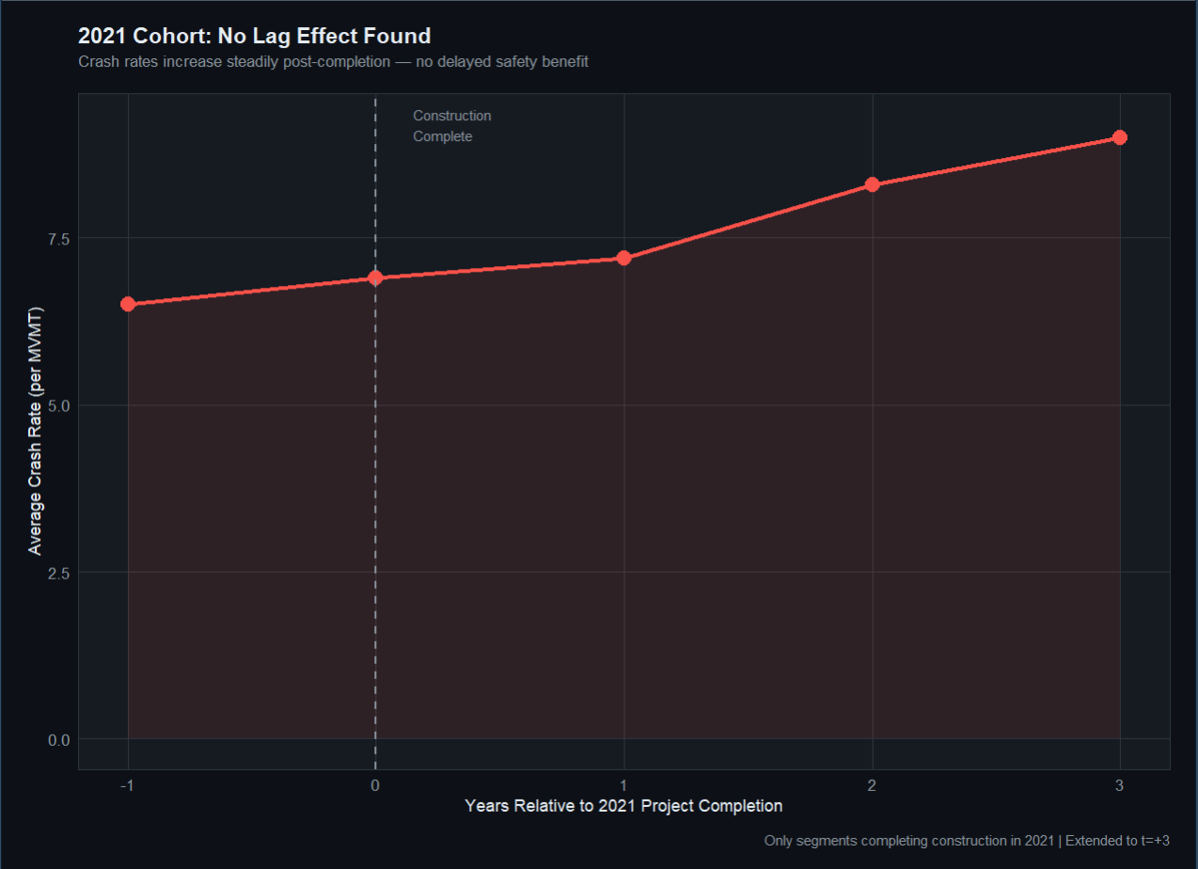
Event Study
Notes:
This chart tracks crash rates over time relative to when each project was completed. T equals zero is the completion year, negative values are before, positive values are after.
2022 was excluded as a transition year — standard practice to avoid mixing active construction observations with clean before and after periods.
What you see is crash rates declining before completion and hitting their lowest point right at t=0, then partially recovering afterward. That pre-completion decline is actually a warning sign — it suggests roads were selected for funding during unusually high-crash periods and were already trending back toward normal on their own. That's called regression to the mean, and it's one of the core challenges in evaluating any road safety intervention. Also, the dip during the construction year is due to the fact that I left out 2022, so I didn’t mix construction periods
To test whether benefits show up later — maybe drivers need time to adjust to the new road design — I isolated just the projects that were completed in 2021 and tracked them out three full years. That's the second chart. Crash rates went up steadily from 6.97 to 8.98 over three years. There is no delayed benefit showing up in the data.
The conclusion from both charts is the same — safety funded projects as a whole are not producing sustained crash reductions over any time horizon we can measure with this data.

Slide 7
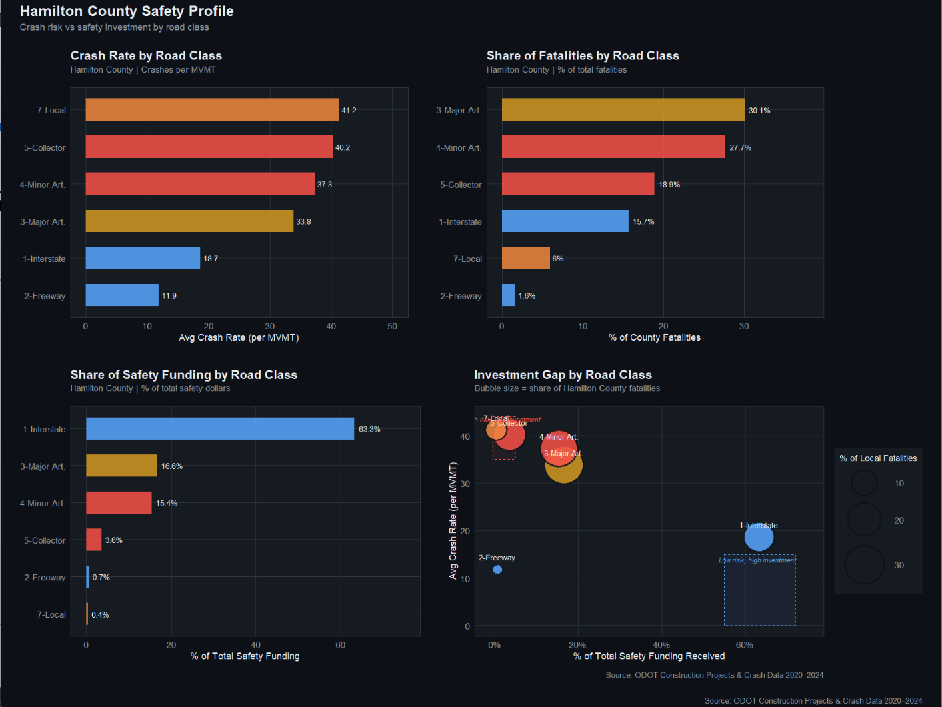
Hamilton County Deep Dive
Notes:
Here's the updated scripts for both slides:
Let's bring this down to our district specifically — Hamilton County. This dashboard shows four views of the same story.
The top left shows crash rates by road class. Local roads and collectors sit at the top — 41 and 40 crashes per MVMT respectively. Interstates sit at the bottom at 18. The top right shows where fatalities actually happen — FC3 major arterials account for 30% of Hamilton County fatalities, FC4 minor arterials 28%, and collectors nearly 19%. Together those three classes account for three quarters of every fatal crash in this county.
The bottom left is where it gets uncomfortable. FC1 interstates — the safest roads in the county by crash rate — are receiving 63% of all safety dollars in Hamilton County. FC5 collectors, which account for nearly 19% of fatalities, receive 3.6%. Local roads receive 0.4%.
The bubble chart on the bottom right puts all of that together in one image. Everything in the red box — high crash rate, low funding — that's where Hamilton County's underserved roads live. Local roads and collectors are sitting in that corner. The interstate bubble is sitting alone in the bottom right — lowest risk, highest investment.
This is District 8's version of the statewide pattern. The numbers are even more skewed here than Ohio as a whole.

Slide 8
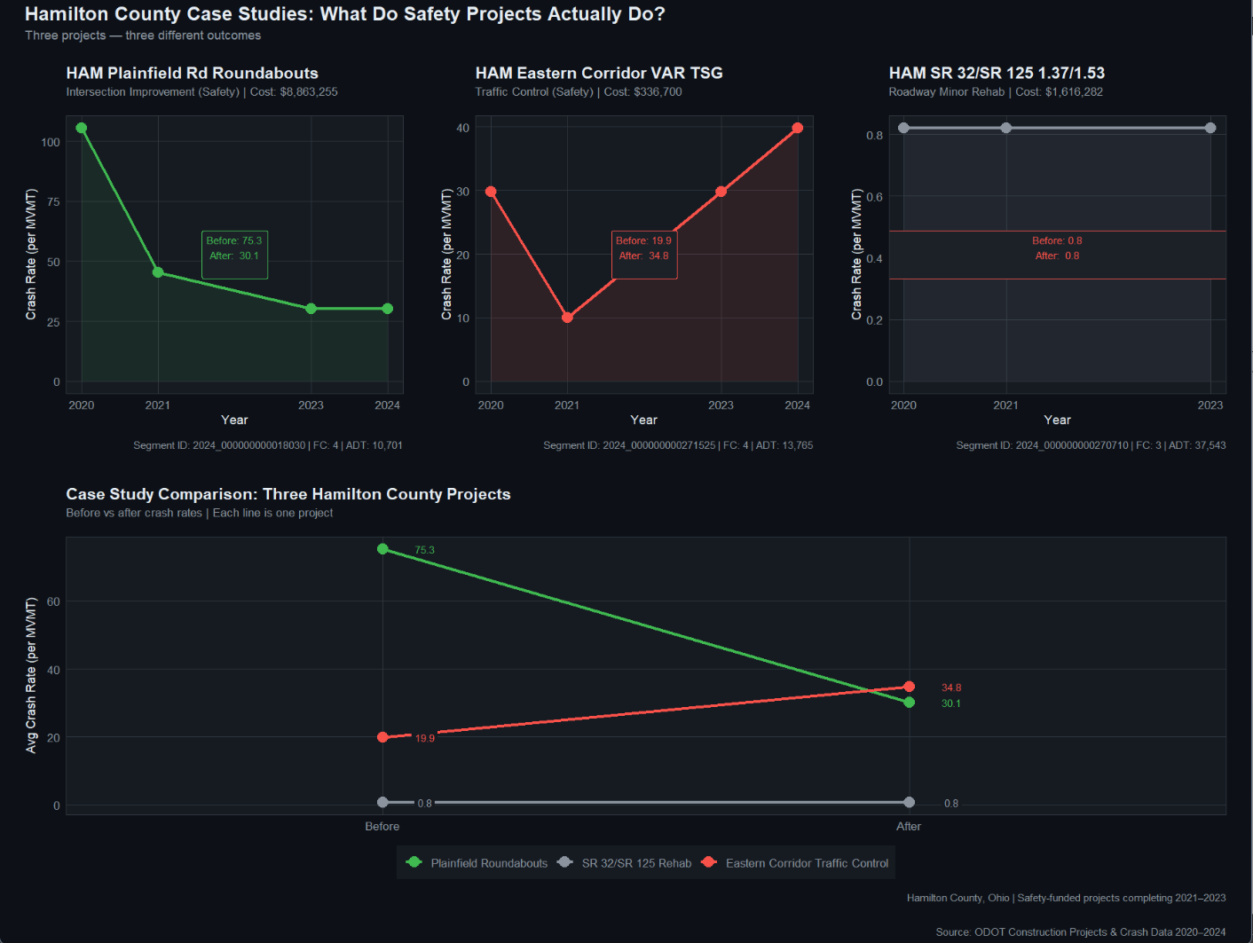
Hamilton Case study
Notes:
Now let me show you three specific projects from Hamilton County that put a face on these aggregate findings.
On the left is the Plainfield Road roundabout project — an $8.9 million intersection improvement. Crash rate dropped from 75 to 30 per MVMT after completion. That's a reduction of 45 crashes per million vehicle miles — one of the strongest results in the entire dataset. This is exactly what a well-targeted safety investment looks like.
In the middle is the Eastern Corridor variable traffic signal project — a $337,000 traffic control intervention. Crash rate went from 20 to 35 after completion — an increase of nearly 15. This road is on FC4, it carries 13,000 vehicles a day, and the safety investment appears to have made it measurably worse. That's a negative return on a third of a million dollars.
On the right is the SR 32 pavement overlay — $1.6 million to resurface the road with a new asphalt layer. Crash rate before: 0.82. Crash rate after: 0.82. Identical. As we discussed earlier, an AC overlay has no mechanism to change how crashes happen — it just makes the road smoother. This project was funded through the safety budget but was never going to move crash rates.
Three projects, three completely different outcomes. One works dramatically. One makes things worse. One does nothing. And yet all three were funded from the same safety budget. That's the core tension this analysis is trying to surface — not that ODOT is doing something wrong, but that the safety label is being applied to a very wide range of interventions with very different actual safety returns.

Slide 9

Where I’m at now
Are intersection improvement projects harder to fund or approve than other project types — and could that explain why they appear underrepresented relative to their safety return?
How does ODOT currently decide which roads get nominated for safety funding — is it primarily driven by crash history, traffic volume, or other factors?
Does the concentration of safety dollars on interstate infrastructure reflect federal funding requirements, or is it a deliberate prioritization decision?
When a project like a pavement overlay is coded as safety-funded, is that because it has a genuine safety component or is it more of a budget classification?
Would a tool that lets your team evaluate project effectiveness by road class and project type at the district level be useful for future funding decisions?
Notes:
"Before I wrap up I want to share what I think the data is pointing toward — but I want to be clear that this is where I'm genuinely looking for your perspective, because you have context that I don't.
One thing I want to acknowledge upfront — pavement maintenance work like AC overlays serves a real purpose that my analysis probably undersells. Good pavement prevents crashes before they happen through better braking, reduced blowouts, improved wet weather performance. That preventative benefit is real, it just doesn't show up cleanly in a before and after crash rate comparison. So when I say pavement projects look like a null result, that's a limitation of the measurement approach as much as anything else. I'd be curious whether that matches your experience on the ground.
What the data does seem to say clearly is that intersection improvements are the one intervention with a measurable and consistent crash reduction effect. The Plainfield roundabout is a great local example of that. My question for you is — are intersection projects harder to fund or approve than other project types?
[Ask other questions]
I don't think there are simple answers to any of these questions — but I think the data raises them in a way that's worth discussing, and I'd really value your perspective on whether these patterns reflect intentional tradeoffs or gaps that are worth examining further.

Slide 10
Where I’m going next – An App
Explore — Interactive map of Ohio crash rates and project locations
Analyze — County and district safety profiles on demand
Evaluate — Before and after effectiveness for any project
Prioritize — Identify which roads need investment most
Update — Upload new data to keep the analysis current
Notes:
The last thing I want to share is where this project is, where I’m hoping to head with this research.
I’m building an interactive application that wraps everything I’ve shown you today into a tool your team could actually use. The idea is straightforward — explore Ohio crash data on a map, pull up a safety profile for any county or district, evaluate whether specific projects worked, identify which roads are most in need of investment, and upload new data each year to keep it current.
I’m still trying to straighten out what exactly the app should be able to do, but I'd love your feedback on what would make something like this genuinely useful for your team day to day — because ultimately I'm building it with ODOT in mind as an end user.

